Slide 1

Jhipster

Slide 2
What is it about?
Modern web apps
Developer productivity
Production ready software

Slide 3
Client side technologies
Npm :
Fast and reliable dependency management
Used to install and run client-side tools
Yeoman:
Generators available
Geared towards JavaScript front-end applications
Bootstrap:
CSS and java elements for all usages
JavaScript components

Slide 4
Client side technologies contd.
webpack :
Compiles, optimizes front-end
Tools to compile angular/react and typescript
Allows production builds on client-side
Angular/react :
Data binding, form validation

Slide 5
server side technologies
Maven/gradle :
Pre-defined directories and goals
Integration with major ides
Spring boot :
IoC and abstractions to ease application coding
Fast and extremely powerful
Out-of-box configuration

Slide 6
server side technologies contd.
jpa :
Hibernate is used underneath
Generates jpa repositories automatically
Spring security:
Secures URLs and Java code
Works with both stateful and stateless web applications

Slide 7
Why jhipster?
Jhipster makes everything easier!
It creates working applications with previously mentioned technologies and more!
webpack works with maven and docker configuration runs everything.
We can run the project using : ./mvnw

Slide 8
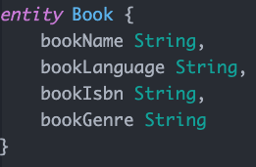
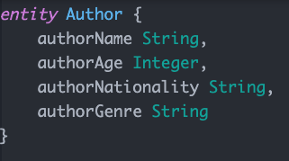
Why jhipster?
Entity: sub-generator to generate complete jpa entity, from database to angular

Slide 9
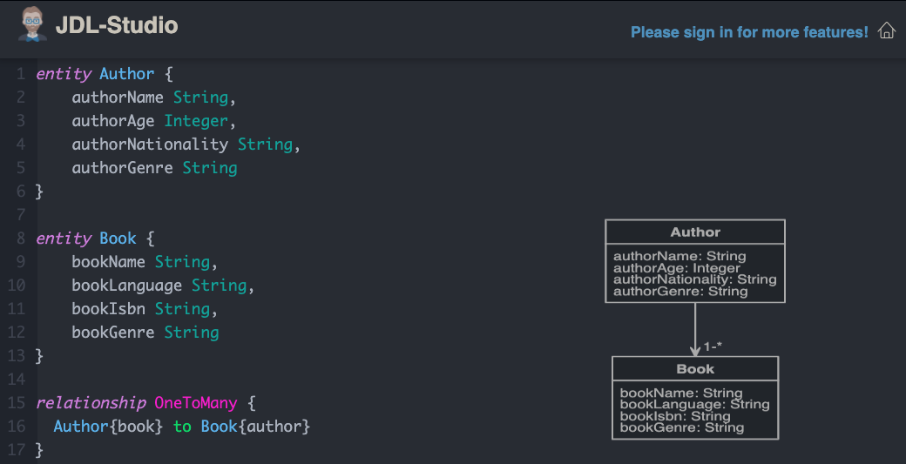
Why jhipster?
Import-jdl: sub-generator to generate a complex entity model using JDL Studio

Slide 10
Thank you!

